Slide 1
VIT – AP UNIVERSITY SCHOOL OF COMPUTER SCIENCE AND ENGINEERING STORAGE TECHNOLOGY AND MANAGEMENT (SWE2005) MODULE- I Dr. G. MUNEESWARI PROFESSOR

Slide 2
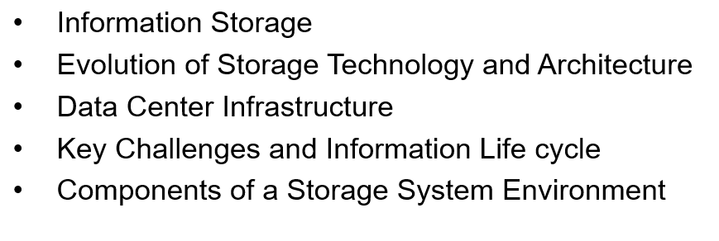
Topics to be Covered

Slide 3
Data Center Infrastructure

Slide 4
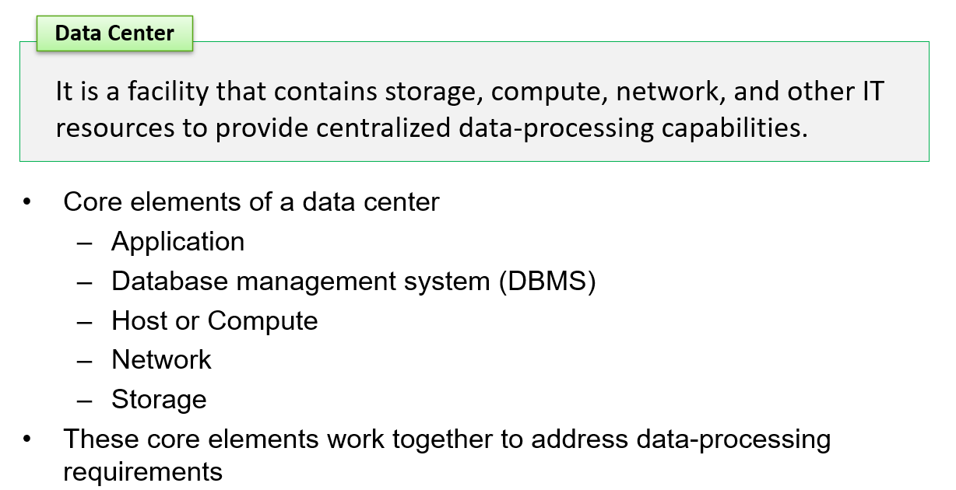
Data Center

Slide 5
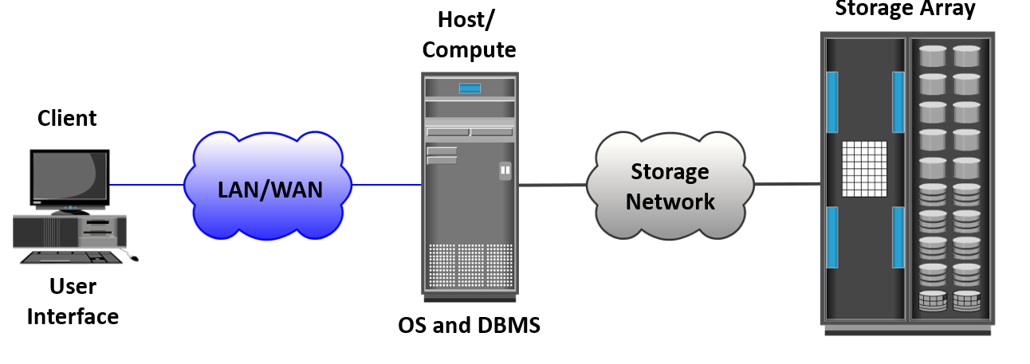
Data Center: Online Order Transaction System Example

Slide 6
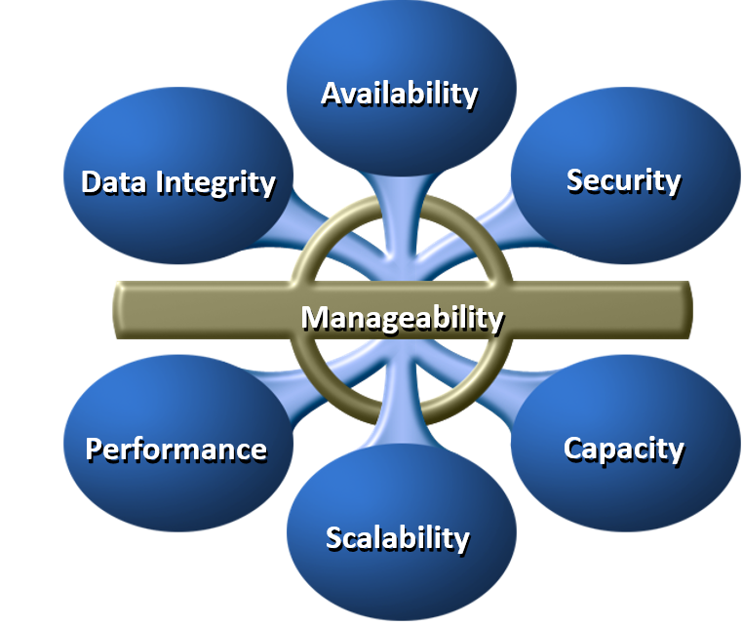
Key Characteristics of a Data Center

Slide 7
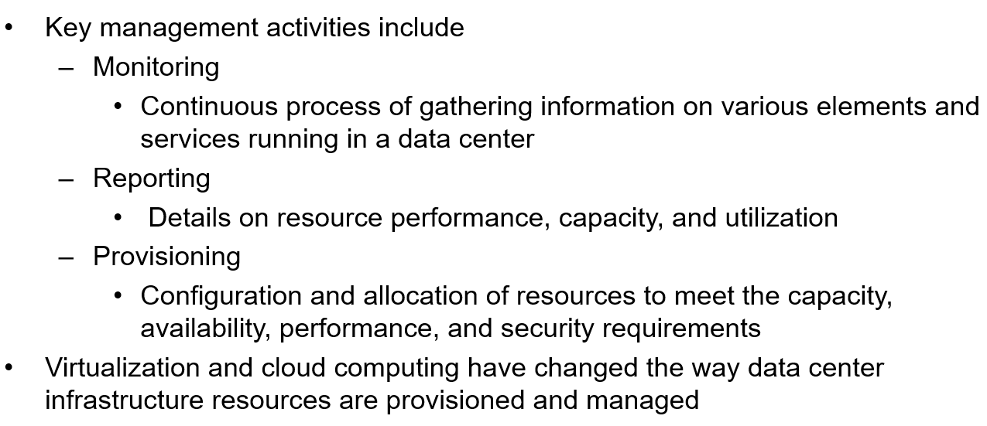
Managing Data Center

Slide 8
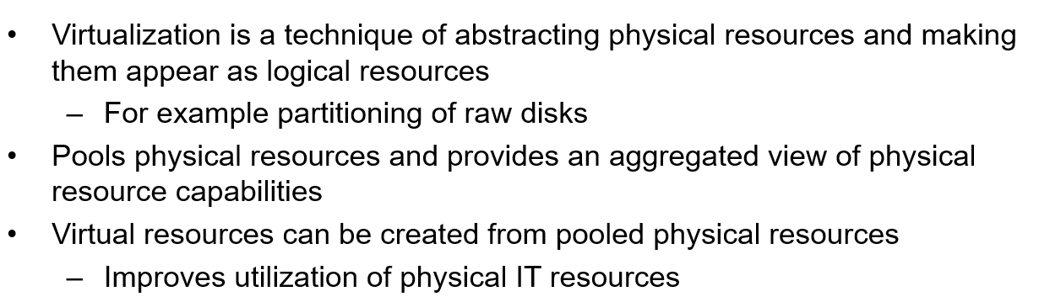
Virtualization: An Overview

Slide 9
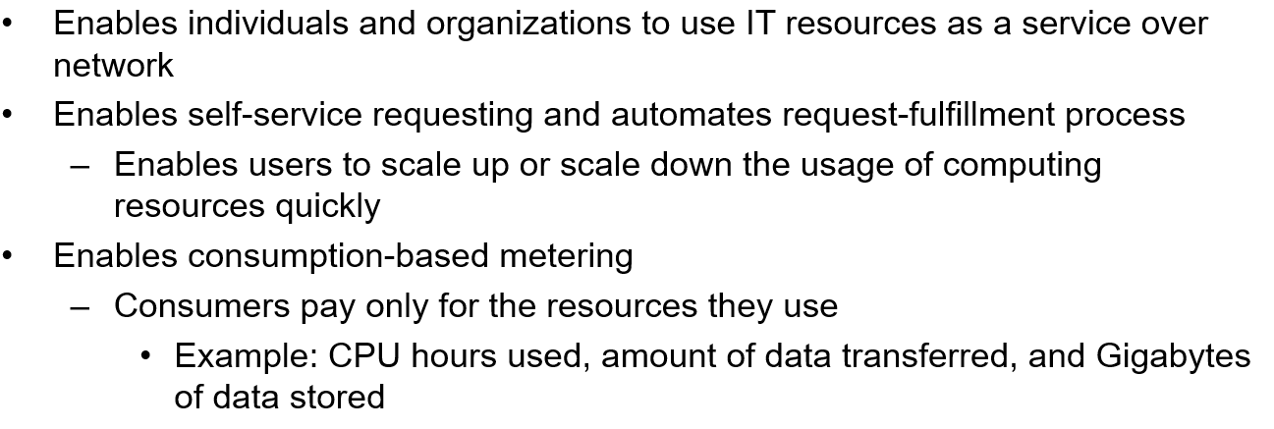
Cloud Computing: An Overview

Slide 10
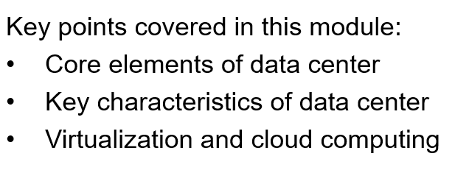
Summary

Slide 11
Key Challenges and Information Life Cycle

Slide 12
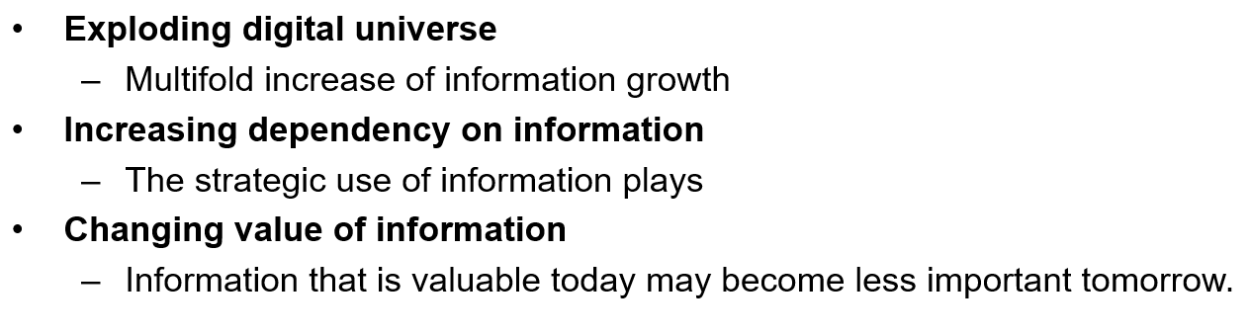
Key Challenges in Managing Information

Slide 13
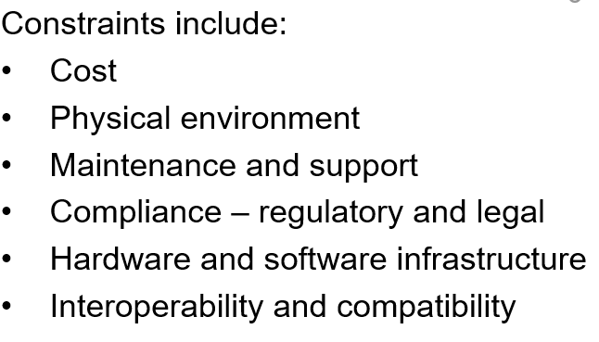
Some Constraints to Meeting the Requirements

Slide 14
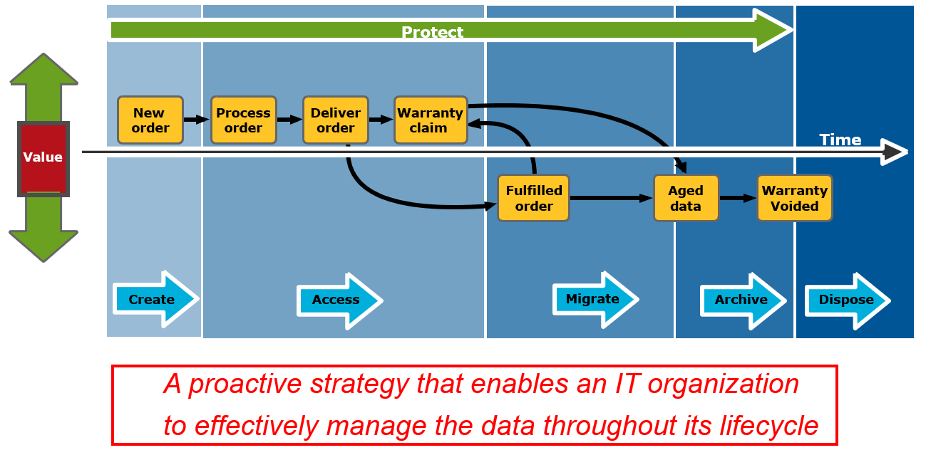
Information Lifecycle Management

Slide 15
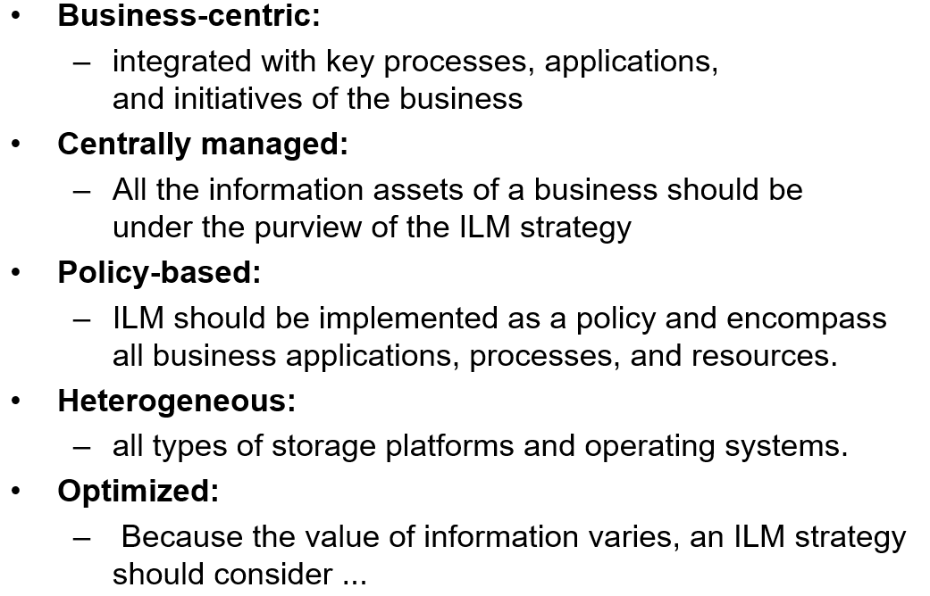
An ILM strategy should include the following characteristics

Slide 16
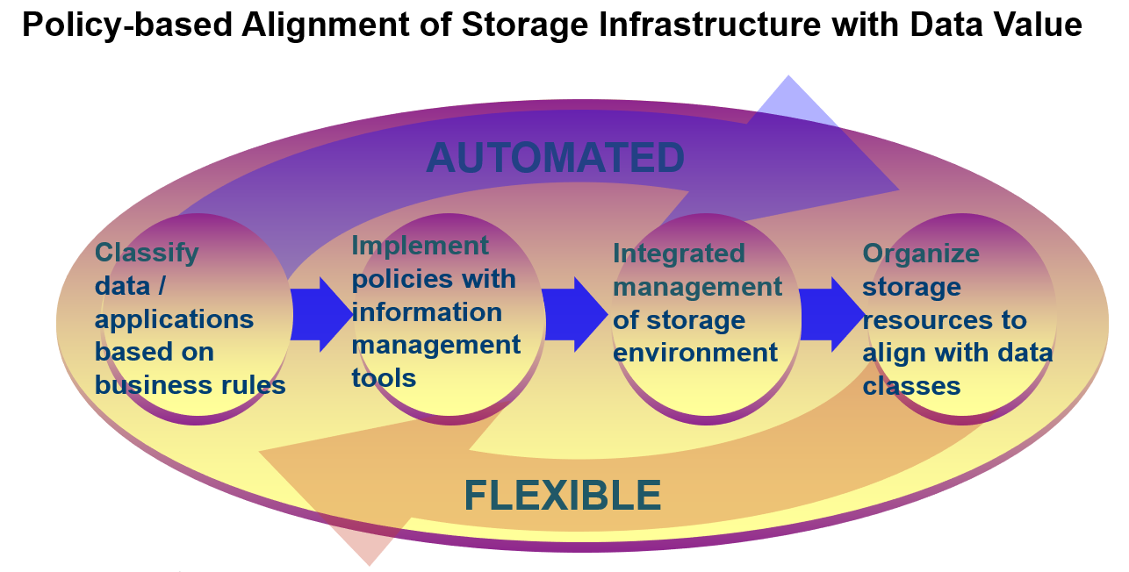
Information Lifecycle Management Implementation

Slide 17
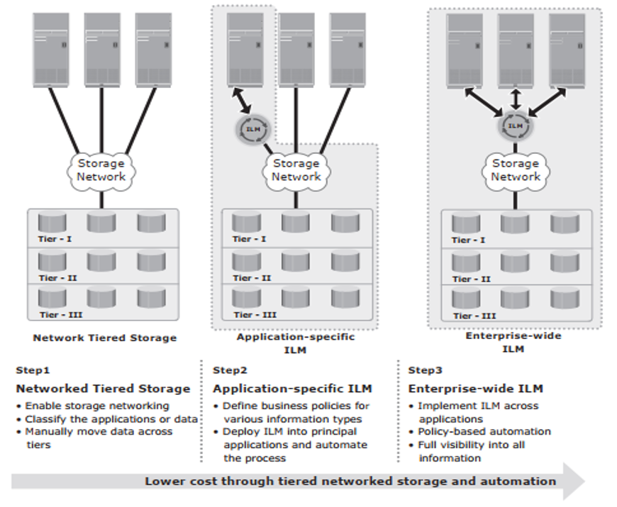
Implementation of ILM

Slide 18
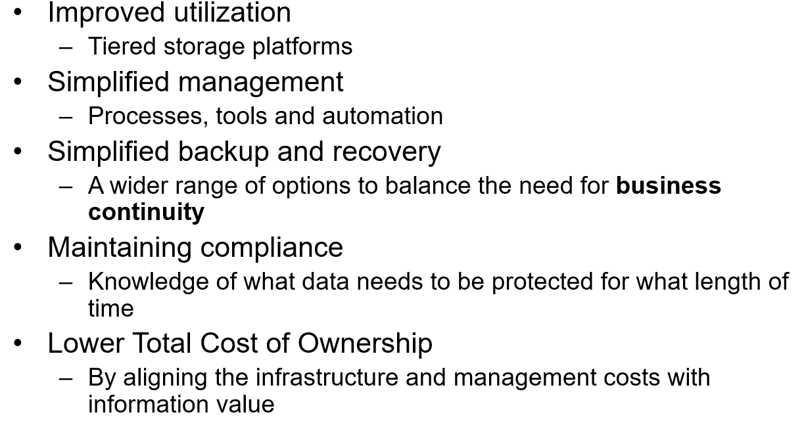
Benefits of Implementing ILM

Slide 19
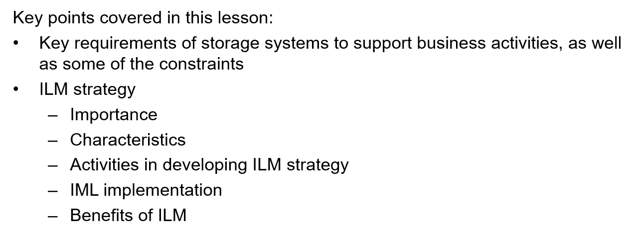
Summary

Slide 20
Components of a Storage System Environment

Slide 21
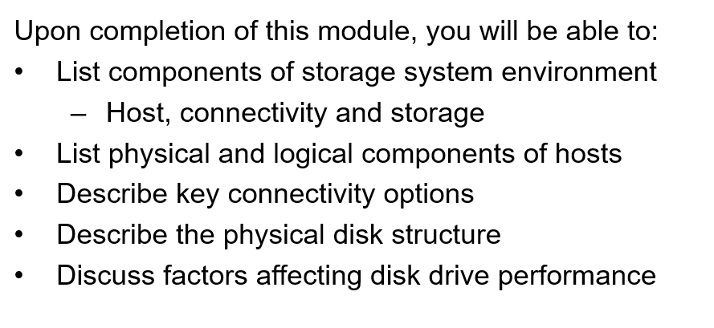
Storage System Environment

Slide 22
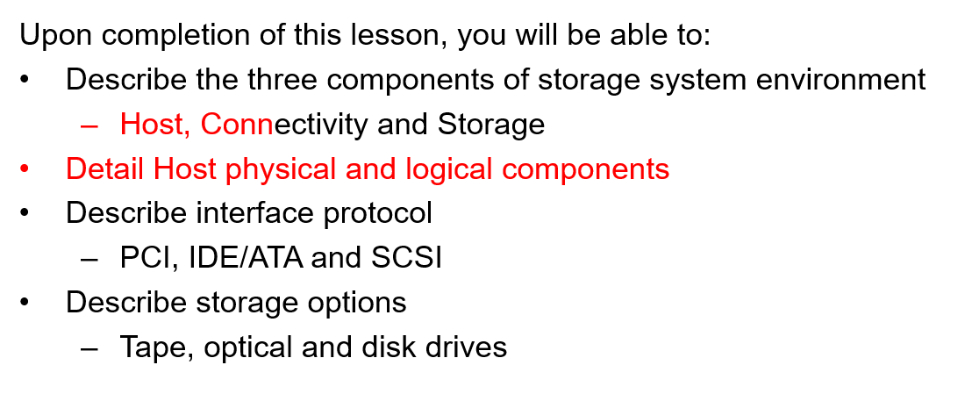
Components of Storage System Environment

Slide 23
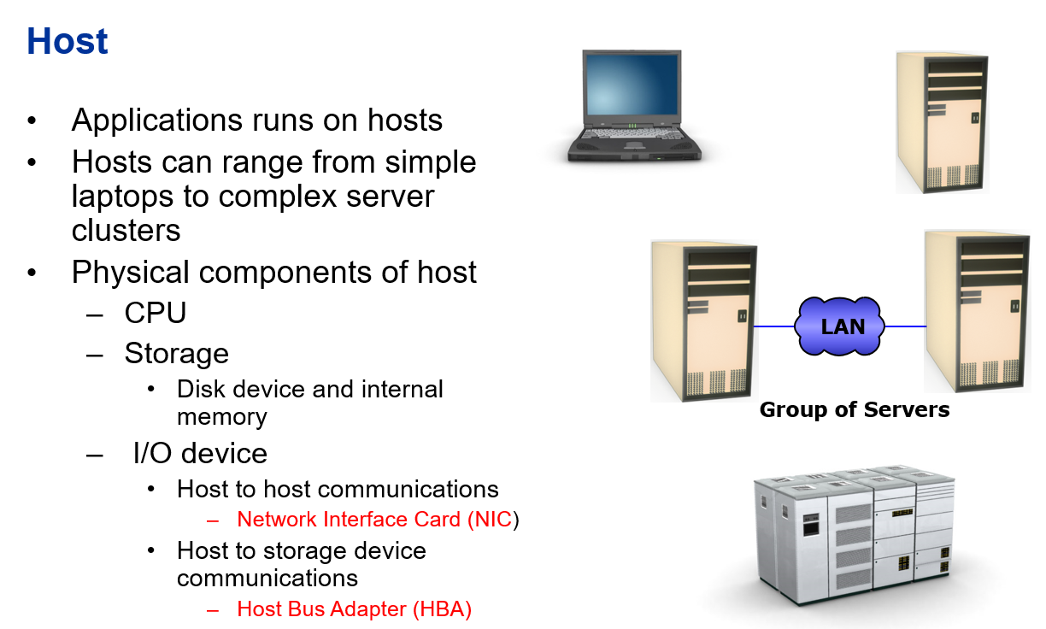

Slide 24
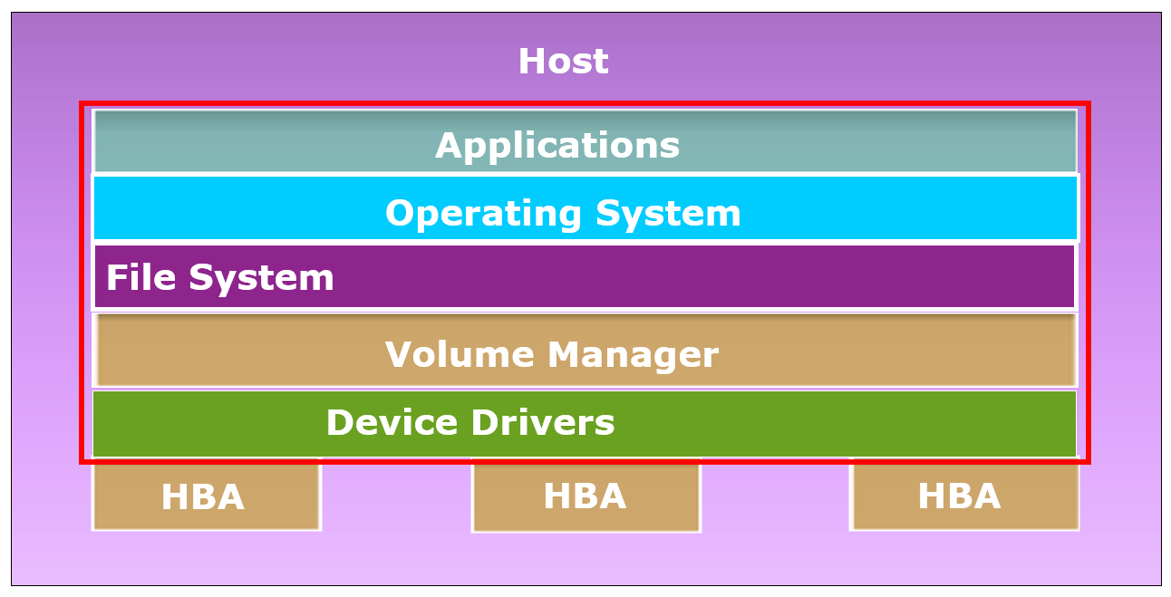
Host: Logical Components

Slide 25
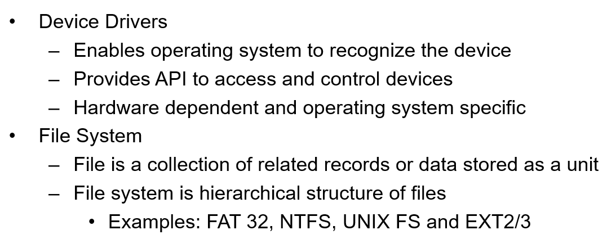
Logical Components of the Host (Cont)

Slide 26
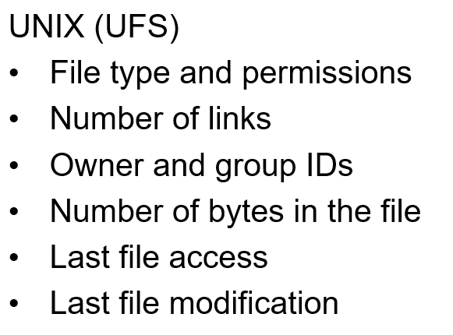
File System: Metadata Examples

Slide 27
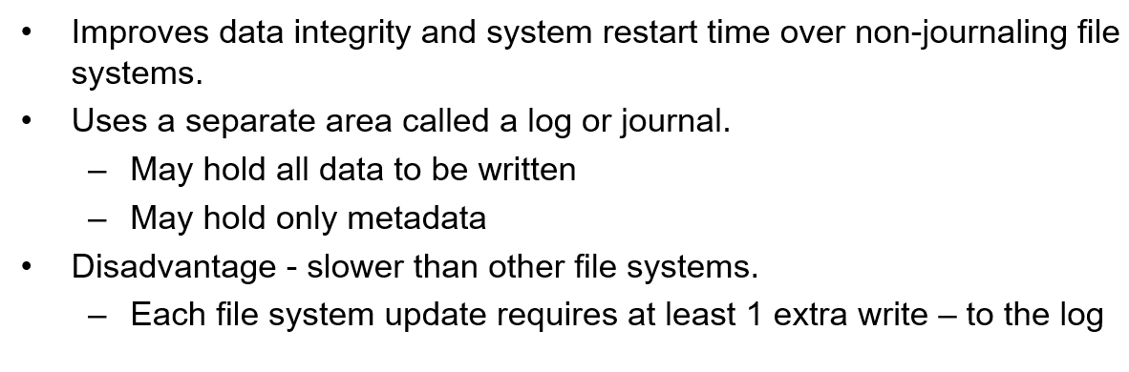
File Systems: Journaling and Logging

Slide 28
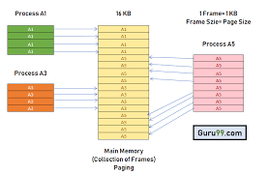

Slide 29
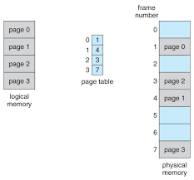

Slide 30
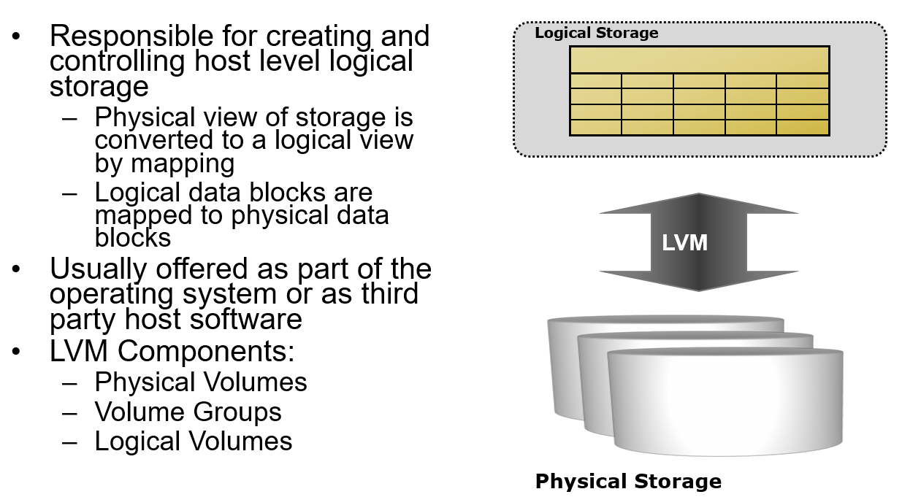
Logical Components of the Host: LVM

Slide 31
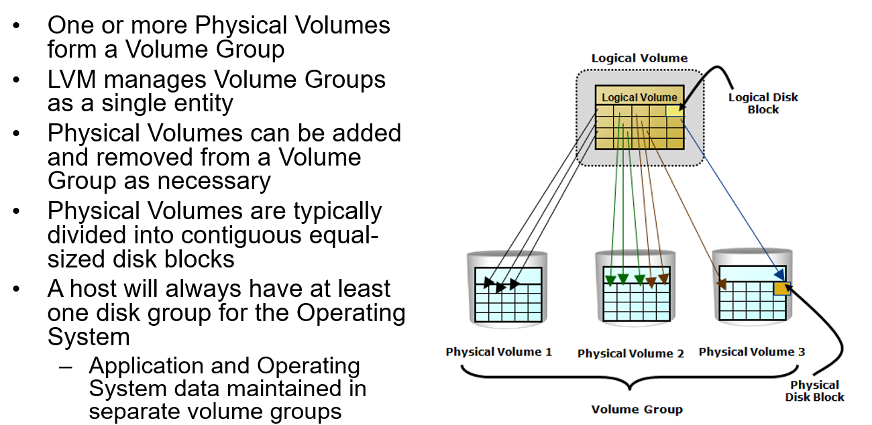
Volume Groups

Slide 32
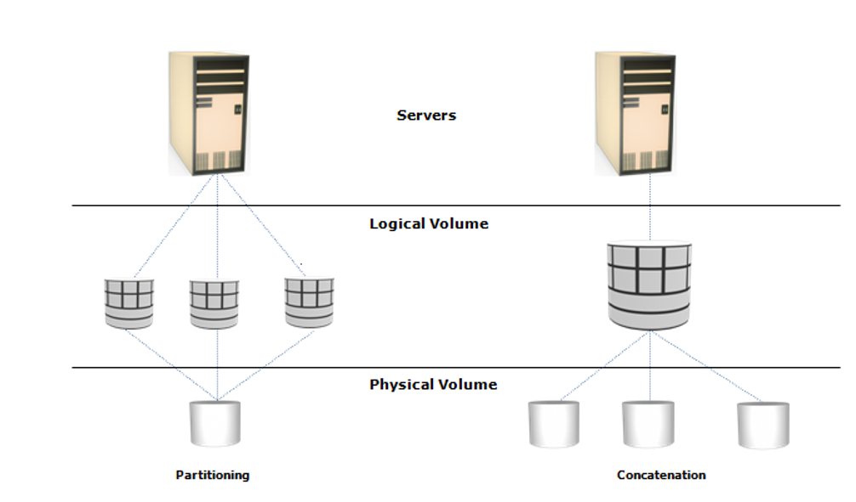
LVM Example: Partitioning and Concatenation

Slide 33
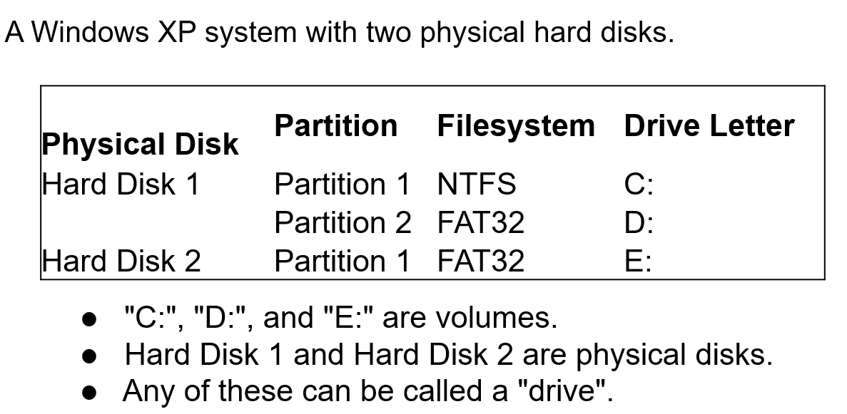
LVM Example

Slide 34
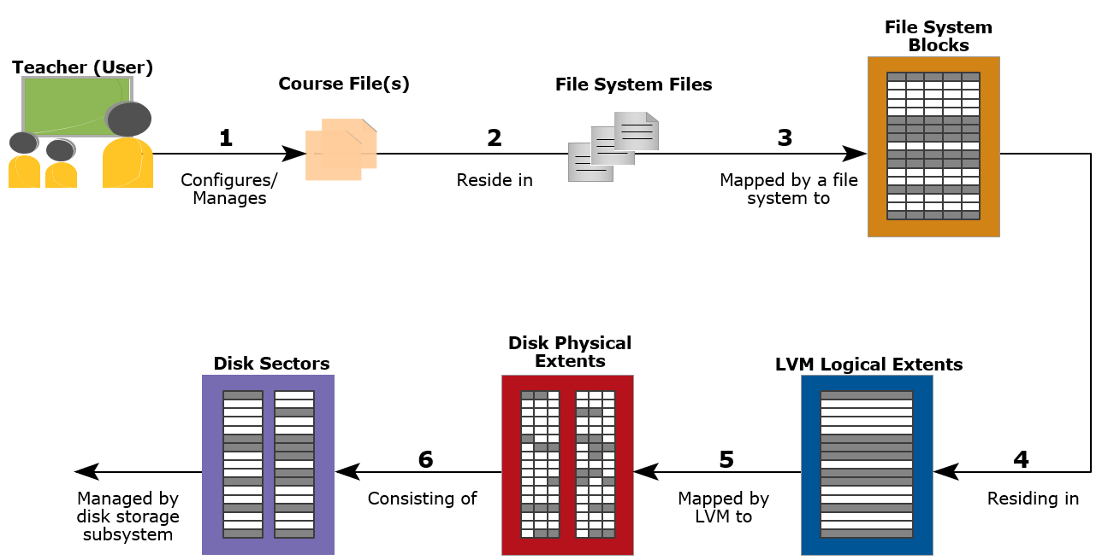
How Files are Moved to and from Storage

Slide 35
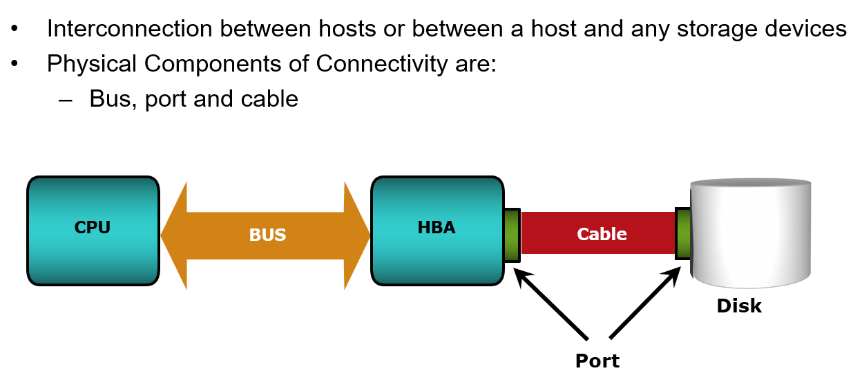
Connectivity

Slide 36
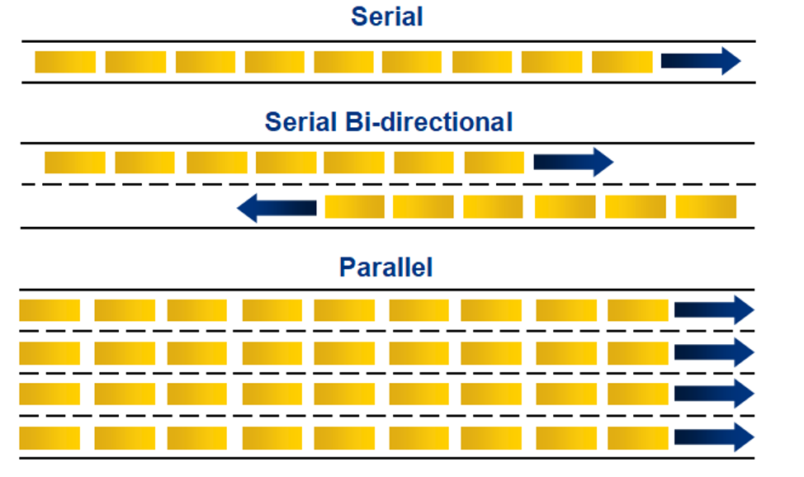
Bus Technology

Slide 37
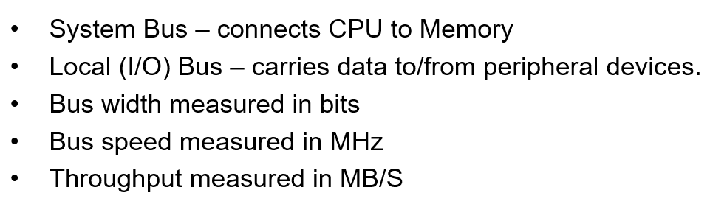
Bus Technology

Slide 38
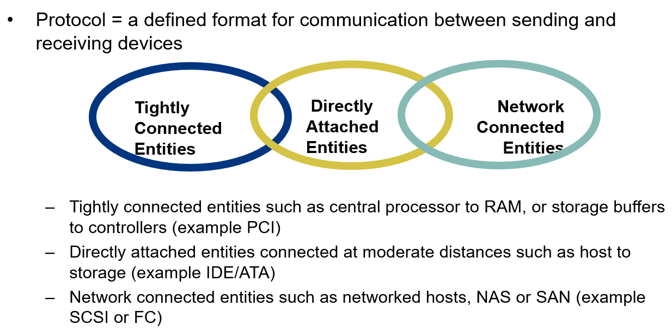
Connectivity Protocol

Slide 39
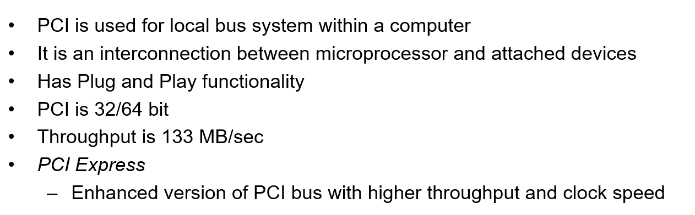
Popular Connectivity Options: PCI

Slide 40
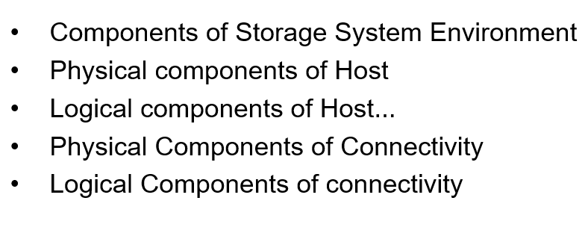
Summary

